Slide 1
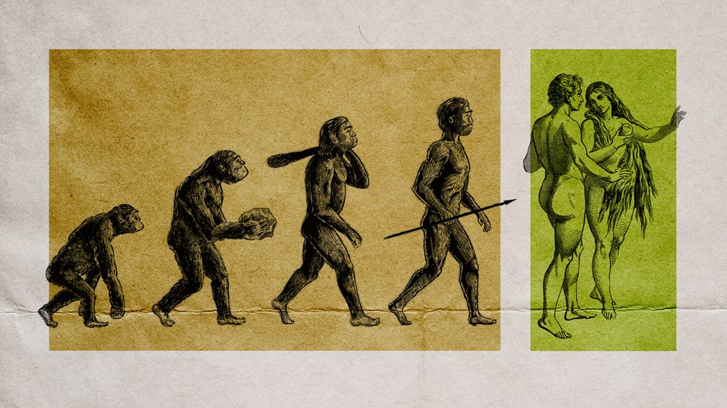
Evolution and Creation
Did we evolve?
Are we created by God?

Slide 2
Problem?
Yesterday we discussed how a great body of scientific evidence shows that different species and different groups of organisms have evolved over time.
These changes happened through changes in DNA sequences leading to changes in genes
It seems as though this means that these changes which led to human beings did so without design or purpose
How do we square this with Divine Revelation which tells us that we are created by God?

Slide 3
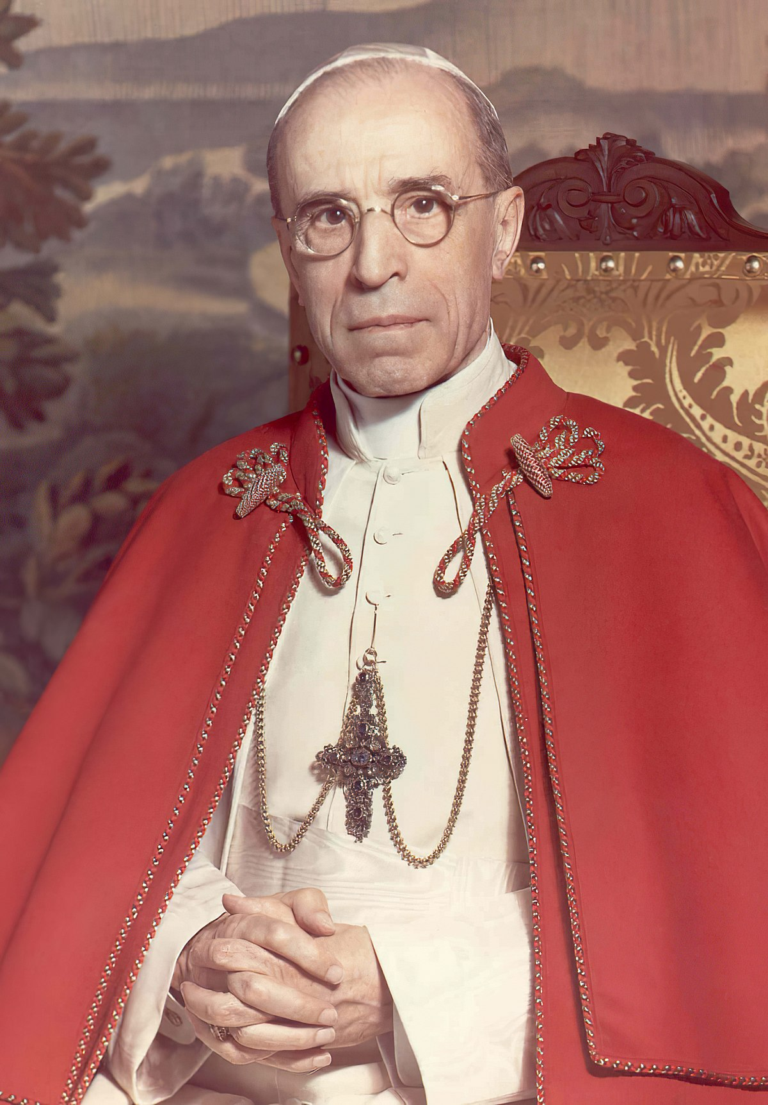
What does the Catholic Church teach about evolution? Does it deny this overwhelming body of scientific evidence?
“There is no intrinsic between Christianity and the theory of evolution”---Pius XII, 1950

Slide 4
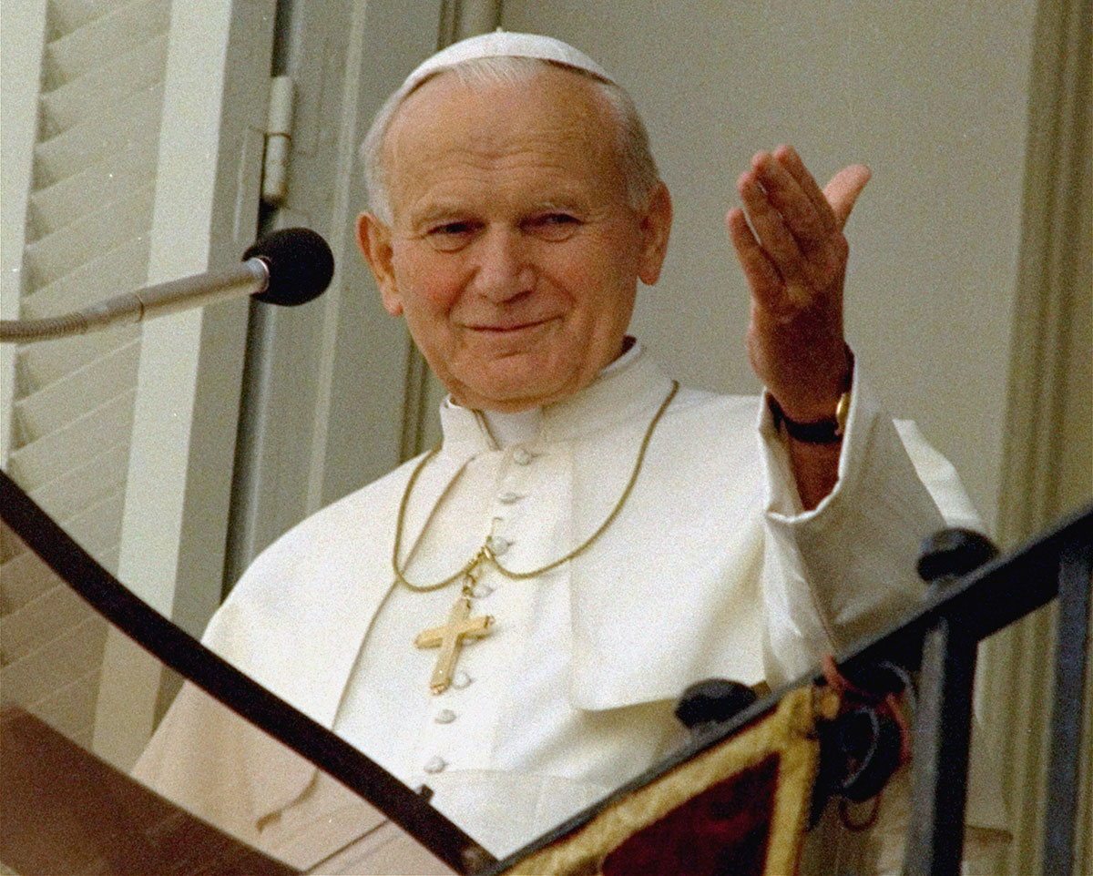
What does the Catholic Church teach about evolution?
“Today…new knowledge has led to the recognition of the theory of evolution as more than a hypothesis…”---John Paul II, 1996

Slide 5
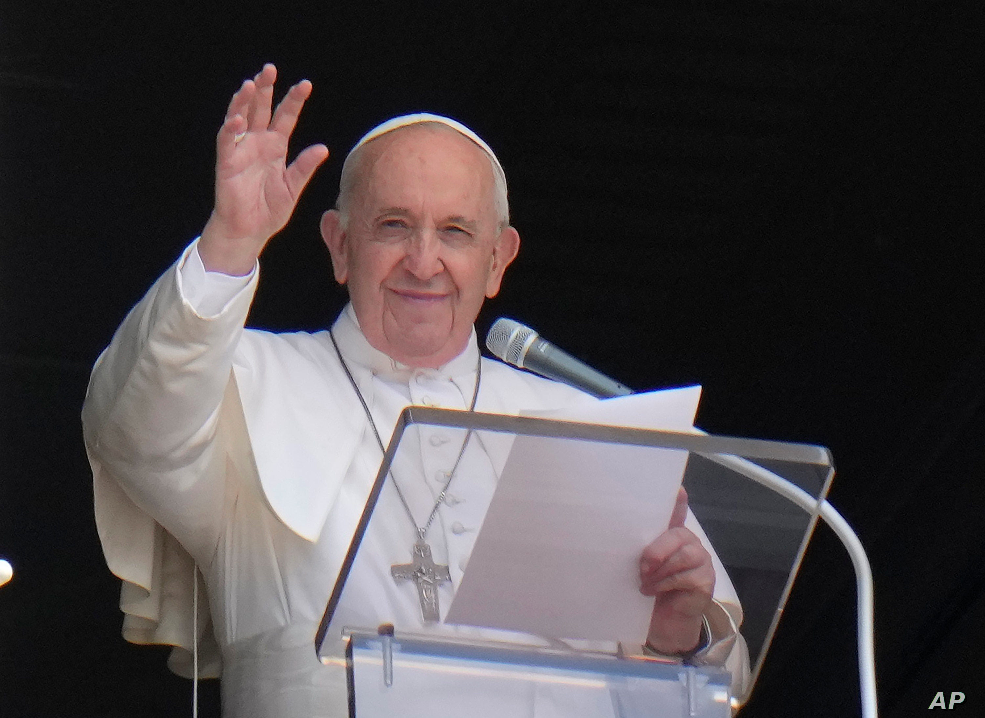
What does the Catholic Church teach about evolution?
“God is not a magician…but the Creator who brought everything to life. Evolution in nature is not inconsistent with the notion of creation, because evolution requires the creation of beings that evolve.”---Pope Francis, 2014

Slide 6
Remember Science and Theology provide us to different ways of looking at reality
These ways are not different versions of reality. They are not at odds. They complement one another.
Science→ tells us how things work by observing them
Faith→ tells us why…why things exist, their meaning and purpose
Let us then go back to the question…
Did our bodies evolve from preexistent matter into the species homo sapiens?
Or were we created by God?
Yes!!!

Slide 7
What kind of God does the bible reveal?
TO Moses he reveals his name: “I AM who I AM.”
God’s essence is existence. Existence is not something he has, but something that He is.
This means that the basic relationship that God has to the world is that of the source of existence of all things.
St. Thomas Aquinas therefore rightly called God the “Primary Cause”
However, in causing all things to be, he causes them to be in such a way that they are able to be causes to each other in various ways.
The universe is therefore filled with various “secondary causes”

Slide 8
All things in the universe have God as their primary cause and various other secondary causes.
They are not in competition with one another.
God is present in the created order…upholding all causes in their causing.

Slide 9
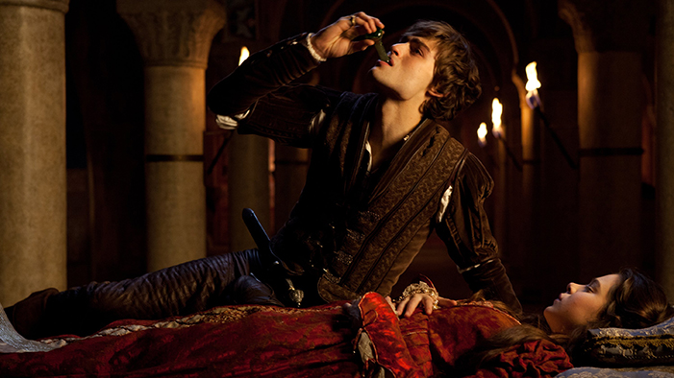
Example:
Consider the play Romeo and Juliet…
Why does Romeo commit suicide?
Is it because Romeo believed Juliet was dead? Or because Shakespeare killed him off?
Yes!!!!

Slide 10
Therefore when we ask the same questions about science and faith…
Did human bodies evolve from other non-rational life forms as science suggests?
Did God create human beings in His image and likeness with a spiritual soul?
Yes!!!

Slide 11
“When we read about Creation in Genesis, we run the risk of imagining God was a magician, with a magic wand able to do everything. But that is not so. He created human beings and let them develop according to the internal laws that he gave to each one so they would reach their fulfillment.”---Pope Francis
“God does not intervene directly in the natural order where secondary causes suffice to produce the intended effect.”---Francisco Suarez S.J.

